Slide 1
Storage Virtualization Brijendra Singh

Slide 2
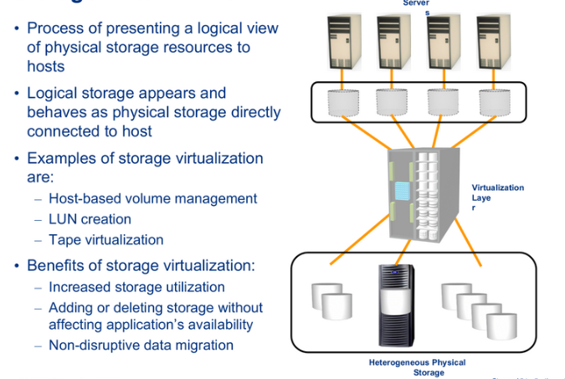

Slide 3
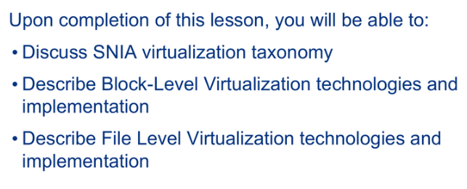

Slide 4
SNIA (Storage Networking Industry Association) storage virtualization taxonomy
It provides a systematic classification of storage virtualization, with three levels defining what, where, and how storage can be virtualized.
The first level of the storage virtualization taxonomy addresses “what” is created. It specifies the types of virtualization: block virtualization, file virtualization, disk virtualization, tape virtualization, or any other device virtualization.

Slide 5
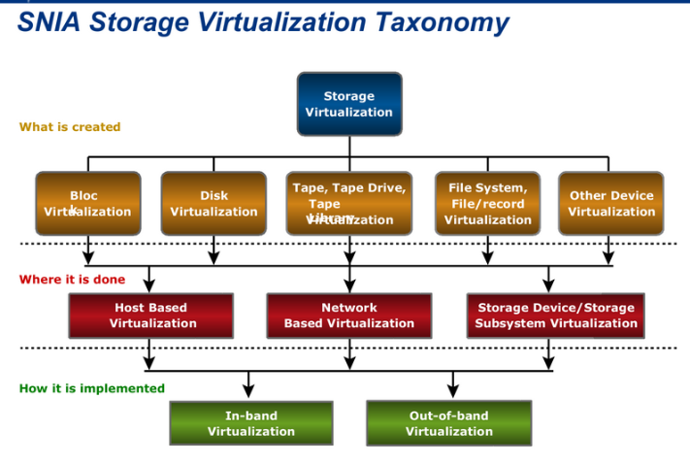

Slide 6
SNIA (Storage Networking Industry Association) storage virtualization taxonomy
The second level describes “where” the virtualization can take place. This requires a multilevel approach that characterizes virtualization at all three levels of the storage environment: server, storage network, and storage.
An effective virtualization strategy distributes the intelligence across all three levels while centralizing the management and control functions.
1. Data storage functions—such as RAID, caching, checksums, and hardware scanning—should remain on the array.
2. Similarly, the host should control application-focused areas, such as clustering and application failover, and volume management of raw disks.
3. However, path redirection, path failover, data access, and distribution or load-balancing capabilities should be moved to the switch or the network.

Slide 7
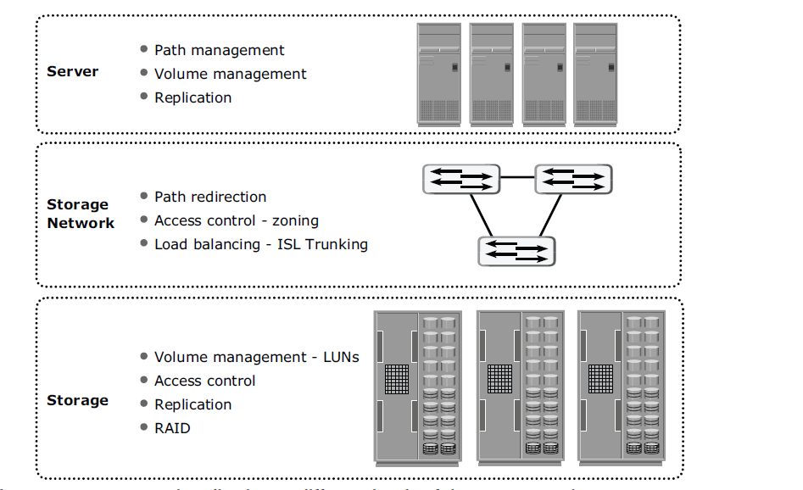
Storage virtualization at different levels of the storage environment
Notes:
ISL-Inner Switch Link

Slide 8
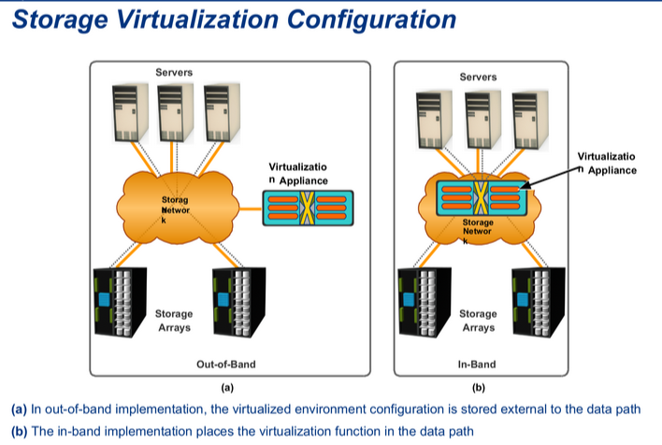

Slide 9
out-of-band implementation
Virtualized environment configuration is stored external to the data path.
This configuration is also called split-path because the control and data paths are split (the control path runs through the appliance, the data path does not).
This configuration enables the environment to process data at a network speed with only minimal latency added for translation of the virtual configuration to the physical storage.
Since the virtualization appliance is hardware-based and optimized for Fibre Channel communication, it can be scaled significantly.
In addition, because the data is unaltered in an out-of-band implementation, many of the existing array features and functions can be utilized in addition to the benefits provided by virtualization.

Slide 10
in-band implementation
The in-band implementation places the virtualization function in the data path.
While processing, data packets are often cached by the appliance and then forwarded to the appropriate target.
An in-band implementation is software-based and data storing and forwarding through the appliance results in additional latency. It introduces a delay in the application response time because the data remains in the network for some time before being committed to disk.
In terms of infrastructure, the in-band architecture increases complexity and adds a new layer of virtualization (the appliance), while limiting the ability to scale the storage infrastructure.

Slide 11
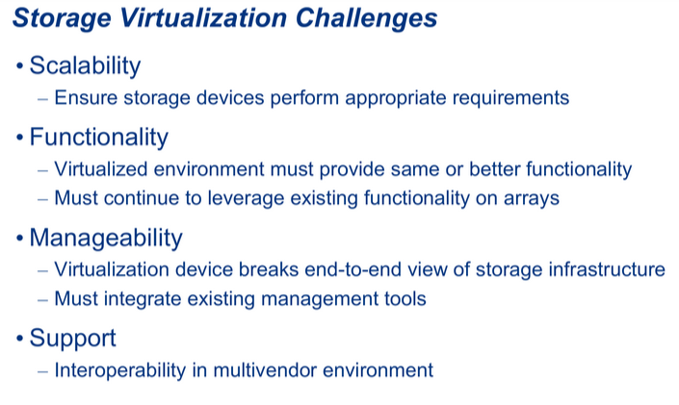

Slide 12
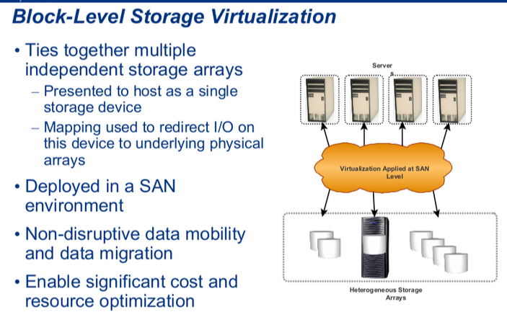

Slide 13
